Slide 1

Artificial Intelligence
Gesture Controlled Virtual Mouse
Presented By :
Vishwa Lathigara (U22CS036) Vandit Patel (U22CS065)
Ankit (U22CS033)
April 2024
NIT Surat
*
Notes:
*
Chandra prakash
RAMAN LAB

Slide 2

INDEX
Introduction of the problem
Applications
Objectives
Input and Output
PEAS
Methodology
Hardware requirement
Look how
NIT Surat
2

Slide 3
INTRODUCTION OF THE PROBLEM
Gesture Controlled Virtual Mouse makes human computer interaction simple by making use of Hand Gestures. The computer requires almost no direct contact. All i/o operations can be virtually controlled by using static and dynamic hand gestures. This project makes use of the state-of-art Machine Learning and Computer Vision algorithms to recognize hand gestures which works smoothly.
NIT Surat
*

Slide 4
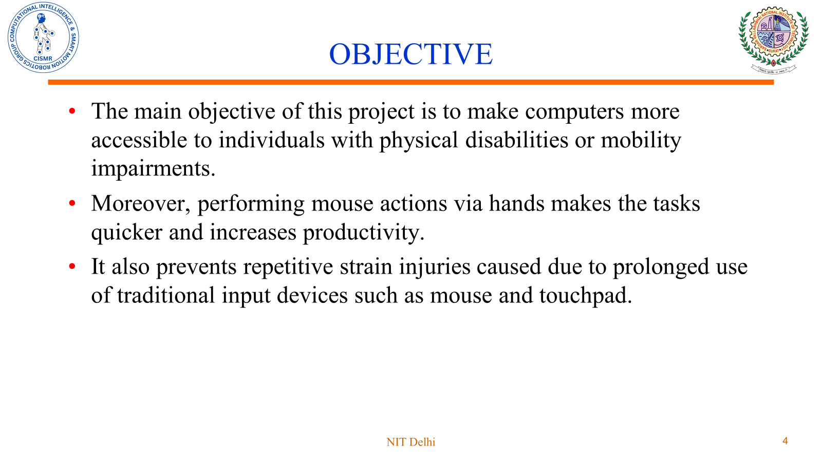
Objectives
NIT Surat
*

Slide 5
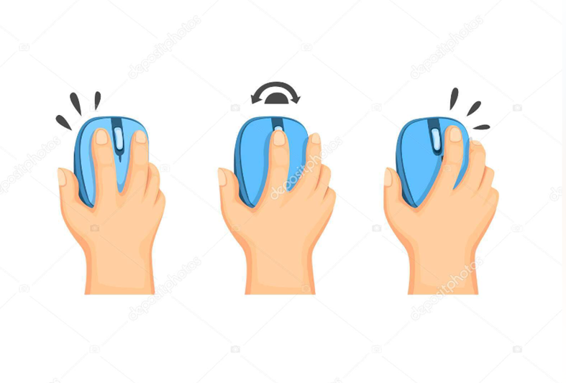

TASKS PERFORMED
The following tasks could be performed by our gesture controlled virtual mouse:
Left-click
Right-click
Double-click
Move cursor
Scrolling
Drag and Drop
Volume & Brightness control
NIT Surat
5

Slide 6

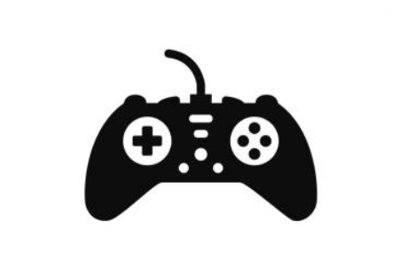
APPLICATIONS
WHERE IT CAN BE USED ?
(1)Presentations:
Presenters can use hand movements to transition between slides and start/stop videos.
(2)Gaming:
This technology can be used in virtual reality gaming environments, and to control various remote
NIT Surat
6

Slide 7
APPLICATIONS
(3)Virtual and Augmented Reality:
Gesture control is often integrated into virtual reality (VR) and augmented reality (AR) systems. Users can interact with virtual objects or navigate through immersive environments using finger gestures.
(4)Accessibility:
Gesture-controlled mouse can enhance accessibility for individuals with physical disabilities who may have difficulty using traditional input devices. Gestures allow users to control the mouse cursor without the need for fine motor skills or physical contact.
NIT Surat
7

Slide 8
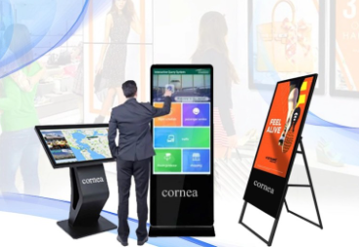
APPLICATIONS
(5)Digital Signage:
Gesture-controlled mouse can be used in digital signage applications where users interact with content displayed on large screens. This can be beneficial in public spaces, retail environments, or museums.
NIT Surat
8

Slide 9
INPUT AND OUTPUT
INPUT:
Gesture Recognition: The system captures and analyzes gestures made by the user. This involves camera to track hand movements and finger gestures.
OUTPUT:
Cursor Movements: Movement of the virtual cursor on the computer screen, and perform corresponding actions by various mouse click gesture. The system translates recognized gestures into corresponding cursor movements.
NIT Surat
9

Slide 10
PEAS
PEAS stand for Performance Measure, Environment, Actuators and Sensors. (1)PERFORMANCE MEASURE:
Objective: The primary goal is to accurately and efficiently control the virtual mouse cursor based on user gestures.
Performance Metrics:
Gesture recognition accuracy.
Responsiveness of the virtual mouse to user movements.
Precision in cursor control.
User satisfaction with the system.
NIT Surat
10

Slide 11
PEAS
(2)ENVIRONMENT: Description: Digital interface of a computer or device where the virtual mouse operates. Characteristics:
-Graphical user interface (GUI) of the operating system.
-Various applications, documents, or web pages that the user interacts with.
(3)ACTUATORS:
Actions Taken: The actuators are responsible for executing the commands derived from the recognized gestures.
NIT Surat
11

Slide 12
PEAS
(4)SENSORS:
Input Sources: Sensors are responsible for capturing the user's gestures and translating them into actionable commands.
Sensors in a Gesture-Controlled Virtual Mouse System:
Camera capturing hand and body movements.
NIT Surat
12

Slide 13
APPROACH
Rule-Based Approach:
We have used the a rule-based approach. In this, the system operates based on predefined rules and conditions. Code defines a set of rules and conditions to interpret hand gestures and perform corresponding actions. For example, when detecting certain hand gestures like a fist or V-gesture, specific actions like mouse clicks or movements are triggered.

Slide 14
ASSUMPTIONS
Environment Setup: The code assumes that the required Python environment is set up correctly, including the installation of necessary libraries.
Camera Access: It assumes access to a camera device for capturing video frames.
Functioning Libraries: The code relies on the proper functioning of various imported libraries such as OpenCV, MediaPipe, PyAutoGUI, pyttsx3, SpeechRecognition, pynput, Wikipedia, comtypes, pycaw, screen-brightness-control, and eel.

Slide 15
ASSUMPTIONS
Default Parameters: Initial configurations like camera resolution, detection confidence thresholds, etc., are assumed to be set to default values.
Basic Error Handling: Basic error handling is assumed to be in place for handling issues like empty frames or missing hand landmarks.

Slide 16
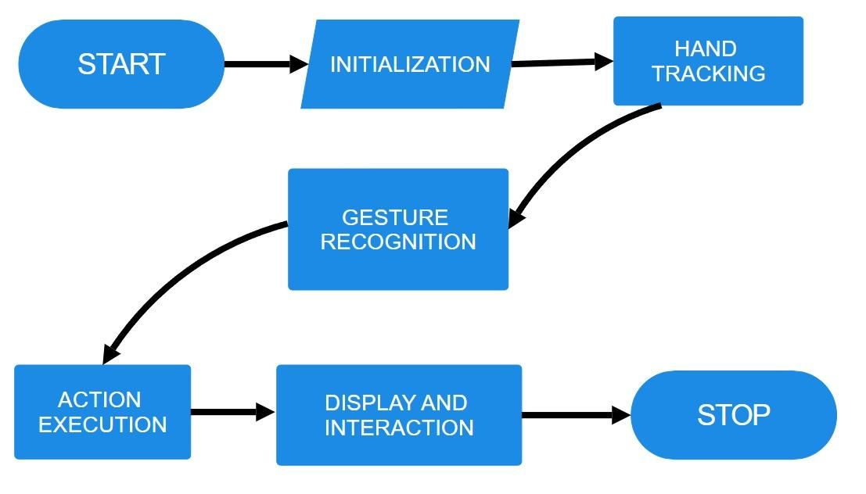
FLOWCHART

Slide 17
IMPLEMENTATION
Initialization:
Start the Gesture Controller.
Initialize the video capture and set up the camera.
Hand Tracking:
Capture a frame from the camera.
Convert the frame to RGB format.
Process the frame using Mediapipe to detect hand landmarks.
Classify left and right hands.

Slide 18
IMPLEMENTATION
Gesture Recognition:
For each detected hand:
Update the hand landmarks in the HandRecog objects (handmajor and handminor).
Calculate the gesture based on finger positions and movements.
Update the gesture state over multiple frames to stabilize the gesture recognition.

Slide 19
IMPLEMENTATION
Action Execution:
Based on the recognized gesture:
Move the cursor or perform mouse actions.
Execute system controls for volume, brightness, scrolling, etc.
Display and Interaction:
Draw the hand landmarks and connections on the frame.
Display the frame with the hand tracking visualization.

Slide 20
LIBRARIES USED
os: This library provides a portable way to interact with the operating system.
cv2 (OpenCV): OpenCV is a popular library for computer vision tasks, such as reading and processing images and videos.
mediapipe: Mediapipe is a library developed by Google for building machine learning-based solutions for various tasks, including hand tracking and gesture recognition.

Slide 21
LIBRARIES USED
google.protobuf.json_format: This library is part of the Google Protocol Buffers library and provides functions for converting Protocol Buffer messages to and from JSON format.
screen_brightness_control: This library provides a cross-platform way to control the screen brightness.
pyautogui: PyAutoGUI is a cross-platform Python module for automating mouse and keyboard interactions.

Slide 22
ALGORITHM AND WORKING
start():
This function is the entry point of the program.
It captures video frames, obtains landmarks from Mediapipe, and passes them to handmajor and handminor objects for controlling.
It utilizes OpenCV to capture video frames and Mediapipe for hand tracking.
classify_hands(results):
This function classifies the major and minor hands based on their labels (left/right) obtained from Mediapipe.
It sets hr_major and hr_minor attributes accordingly.

Slide 23
ALGORITHM AND WORKING
handle_controls(gesture, hand_result):
This function implements all gesture functionalities.
It performs actions based on the detected gestures and hand results.
If gesture is V_GEST
Move the cursor to the hand position
Else if gesture is FIST
If grabflag is False
Press and hold the left mouse button
Move the cursor to the hand position

Slide 24
ALGORITHM AND WORKING
Else if gesture is MID and flag is True
Perform a left mouse click
Else if gesture is INDEX and flag is True
Perform a right mouse click
Else if gesture is TWO_FINGER_CLOSED and flag is True
Perform a double mouse click
Else if gesture is PINCH_MINOR
If pinchminorflag is False
Initialize pinch control
Perform pinch control for vertical scrolling

Slide 25
ALGORITHM AND WORKING
Else if gesture is PINCH_MAJOR
If pinchmajorflag is False
Initialize pinch control
Perform pinch control for system brightness/volume adjustment
pinch_control(hand_result, controlHorizontal, controlVertical):
This function controls pinch gestures for either horizontal or vertical scrolling.
If pinch direction is along y-axis
Set pinch direction flag to False

Slide 26
ALGORITHM AND WORKING
If pinch displacement is below threshold and similar to previous displacement
Increment frame count
Else
Update pinch displacement and reset frame count
Else if pinch direction is along x-axis
Set pinch direction flag to True
If pinch displacement is below threshold and similar to previous displacement
Increment frame count

Slide 27
ALGORITHM AND WORKING
Else
Update pinch displacement and reset frame count
If frame count reaches threshold
Reset frame count and set pinchlv to prevpinchlv
Call controlHorizontal if pinch direction is True, otherwise call controlVertical

Slide 28
METHODOLOGY
Implement Virtual Mouse Controls:
Design and implement the virtual mouse controls based on the recognized gestures.
Include functionalities such as cursor movement, left-click, right-click, scrolling, and zooming.
Testing and Evaluation:
Test the virtual mouse controls in various scenarios and environments.
Optimization and Performance Tuning:
Optimize the system for performance, considering factors such as speed, responsiveness, and resource utilization.
NIT Surat
28

Slide 29
HARDWARE REQUIREMENT
Hardware
Camera (Laptop camera/Mobile camera/webcam)
Software
Python 3
OpenCV Library
OS
Media pipe
NIT Surat
29

Slide 30
OUR LEARNINGS
Computer Vision:Utilised computer vision techniques for hand tracking and gesture recognition,leveraging OpenCV and mediapipe libraries
Gesture Recognition: Implemented algorithms for recognizing and interpreting hand gestures, enabling intuitive interaction with computers.
Human-Computer Interaction (HCI): Explored the application of gestures as a natural and efficient means of interaction between humans and computers, enhancing user experience and interface design.

Slide 31
REFERENCES
•Class Notes: https://cprakash86.wordpress.com/csb-210-ai-2024/
•Opencv Documentation: https://docs.opencv.org/3.4/d1/de5/classcv_1_1CascadeClassifier.html
•Mediapipe Documentation:https://developers.google.com/mediapipe/
•Error Solving & Debugging: https://stackoverflow.com/

Slide 32
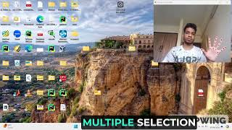
LOOK HOW
NIT Surat
32

Slide 33
THANK YOU !!!

